Slide 1



Kuaishou App Recommendation system
Group 10 members
Zeyad Mohamed Kariman Mousa

Slide 2
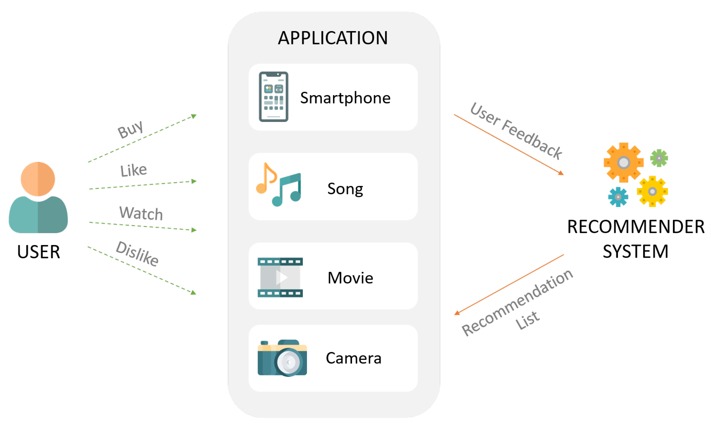
What’s the recommendation systems?
recommendation systems is an intelligent computer-based technique that predicts based on users’ adoption and usage and helps them to pick items from a vast pool of online stuffs.

Slide 3

Datasets
BIG_MATRIX
user_id
video_id
Timestamp
watch_ratio
play_duration
Time
date
SMALL_MATRIX
user_id
video_id
Timestamp
watch_ratio
play_duration
Time
date
Item_feat
video_id
feat
Social_network
user_id
friend_list
big_matrix.csv
small_matrix.csv
Social_network.csv
Item_feat.csv

Slide 4
Datasets cont.
big_matrix
consists of 12530806 rows and 8 columns we use it as training matrix
small_matrix
consists of 4676570 rows and 8 columns we use it as evaluation
social_network
we can leverage from the data in this dataset if we’re going to use item-item collaborative filtering approach, and to recommend videos to users based on their feats preferences.
this dataset set will help us to answer the third question which says if the shorter videos is preferable by users than longer videos.
it has no missing values and 965819 consistent duplicated values
matrix and we’ll predict the watch_ratio values because we considered that if the user-video pairs has high watch ratio that means the user liked the video(first and second questions)
help us to answer the third question which says if the shorter videos is preferable by users than longer videos.
this dataset has 181992 values in time features.
Item_feat
we can leverage from the data in this dataset if we’re going to use user-user collaborative filtering approach, and to recommend videos to users based on their friends’ preferences, , if we assume that the friends have the same preferences.

Slide 5
Data preprocessing
1. Remove missing values:
1.1 check for any missing values in every dataset.
1.2 small_matrix dataset is the only matrix which has 3.8% null values from its total data in three features (time, data, timestamp),we plot the missing bar and missing matrix to have a better view, and we found they are missing in MAR technique, and since the three features follow the same pattern in missing values and since we won’t use any time features in our predictive model or recommendation model, so I’ll drop these features.
Remove duplicated values: there are no datasets have consistent duplicated values except for big_matrix.csv it has about 1 million duplicated recorded even in IDS and timestamp, so we dropped them.
3. Handling outliers: we have outliers in four datasets, but we considered them as true outliers which means that they have informative values, and they are outliers not because human or machine error but because they are coming from updated feedback, so we decided to normalize video_duration and play_duration values between 0 and 1 and we kept IDs as it is.

Slide 6
Main three questions
What’s the watch_ratio of video for each pair of user and video?
Answering to this question will help a lot of foundations like advertisement agents while the answer will tell them where they should put their advertisements and will help the content creator, I tend to answer this question by creating a neural network model to predict the value of watch_ratio value.
Main finding:
after we train it on big_matrix.csv for 10 epochs and adam optimizer with learning rate 0.01 and evaluate it on small_matrix.csv (watch_ratio) we got 5.124 as MSE, but we it took much time to converge.

Slide 7
Does the user like the video or dislike it?
The answering to this question is related to the previous one, if the watch_ratio is higher
than specified value then the user liked this video otherwise he disliked it also, like
the previous question Answering this question will help advertisement agents because
the answer will tell them what’s the most likes videos and where they should put
their advertisement, also it will help the recommendation system engine to recommend
videos to users like they pressed like button on them based on another features like tags, and using the same previous model.
Main finding:
after we train it on big_matrix.csv for 10 epochs and adam optimizer with learning rate 0.01 and evaluate it on small_matrix.csv (liked labels) we got 82% as accuracy score, but we it took much time to converge.

Slide 8
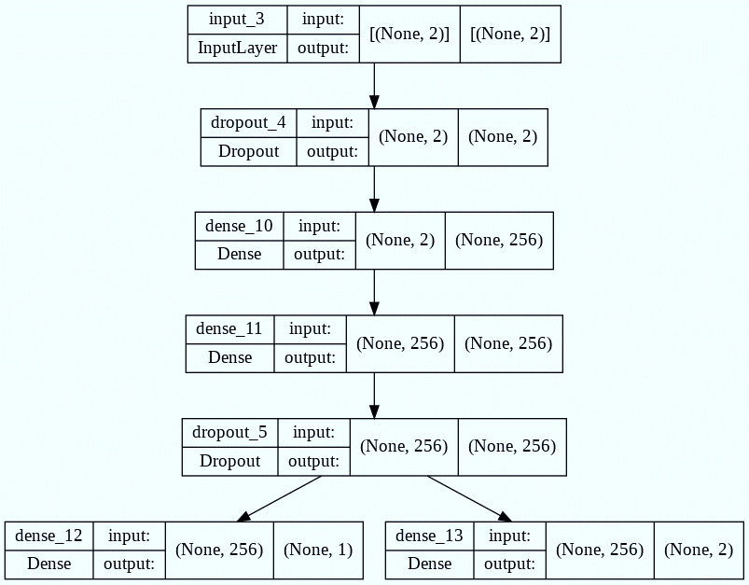
Model layers

Slide 9
Are the shorter videos {less than 2 or 1 minutes} are more favorite than (more than) longer videos for the users?
1. Answering these questions will help the app founder to determine what’s the best video duration
that users like, and how each user will stay in the app, also they will recommend these videos to
more people, and it’ll appear at the top of the page to the users, also it will help content creators
to choose the best video duration to attract more users to their videos, we will answer this
Question Using statistical hypotheses test,
H0: The shorter videos {less than 1 minutes} are more favorite than (more than) longer
videos for the users.
H1: Both type of these videos have the same degree of preferences?
2. Main findings: after applying our hypotheses test: we found that the value of significance level
in small_matrix.csv and big_matrix.csv is near to 0 and we sit a condition if the significance level
was greater than 0.05 then we accept the null hypotheses else we accept the alternative hypotheses,
and in the both cases we accept the alternative hypotheses, and we see that’s reasonable output.

Slide 10
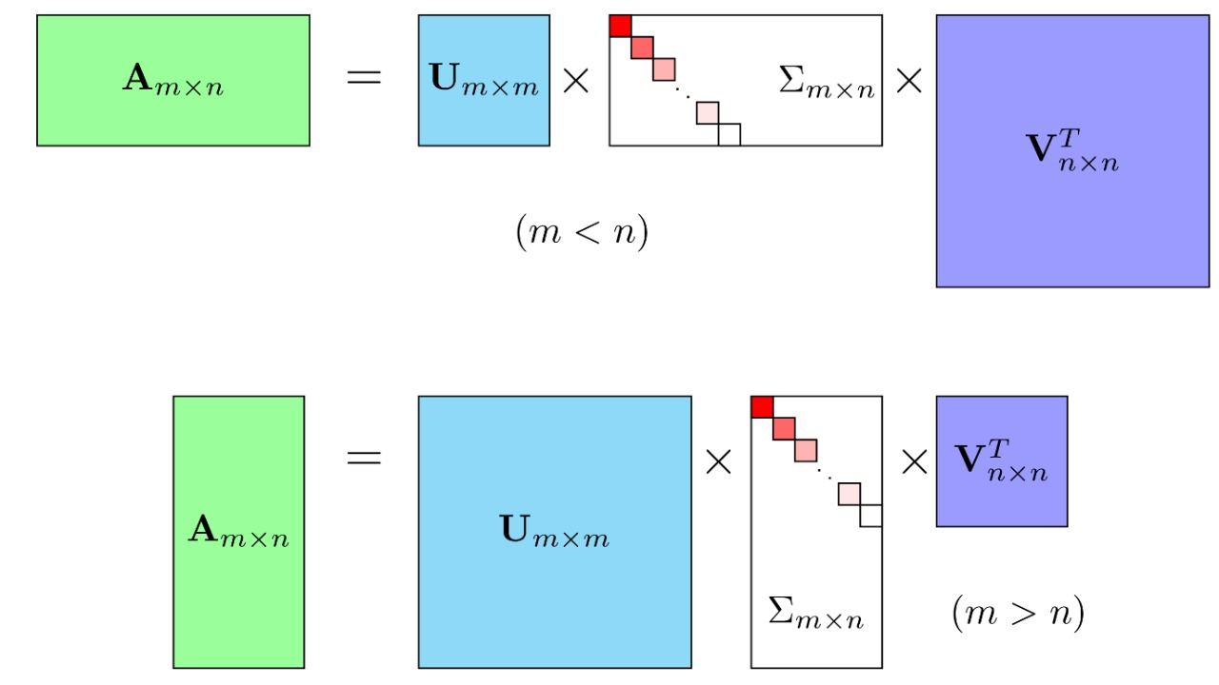
SVD model for videos Recommendations
We tend to apply this approach basic version of model-based collaborative filtering for recommendations by employing it on the merged big_matrix.csv and small_matrix.csv after we preprocessed both matrix, and join feat_item.csv to new merged dataset, and after that we introduced Singular Vector Decomposition (SVD) to you, a powerful dimensionality reduction technique that is used heavily in modern model-based CF recommender system, and our evaluation here will be Root Mean Squared Error

Slide 11
Limitations and the problems
Huge dataset: our dataset contains 12530806 rows for training dataset, and 4676570 rows for testing dataset which consider a big data and that takes a long time for showing it not to mention preprocessing its data or try to train the train dataset or predict column values in the test dataset, and it would take a long of time if we tried to apply Collaborative Filtering techniques.
2. cold start problem: we faced a problem in which recommending items to users in case there is very little data available related to the user or item.
3. Scalability: Data is always up to date.
4. Sparsity: users do not provide likes or reviews for the things they watch.

Slide 12
Conclusion
In this presentation, we present KuaiRec, a fully-observed dataset in recommender systems. We focus on using this dataset to study how can we preprocess and analyze this dataset and recommend the possible best videos for the users based on two approaches the first one is to predict the watch ratio and whether the user liked the video or not using fully connected neural network and then either join the item_feat.csv with small_matrix.csv or big_matrix.csv to recommend the users who liked a video from specific category the same category or join the social_network.csv with small_matrix.csv or big_matrix to recommend the video who users like to his friends.
Another approach is to use Model-Based Collaborative Filtering, which is based on Support Vector Decomposition (SVD), and this approach is very good because it will enable us to get the best possible videos for the user without depending on the other datasets.

Slide 13



